Slide 1
Module 8 Guidance Notes (8.1) Pointers
COMP2113 Programming Technologies
ENGG1340 Computer Programming II

Slide 2
What are we going to learn?
Memory addresses and pointers
Pointers and arrays
Pass-by-reference with pointers

Slide 3
Memory Address
The main memory of a computer can be regarded as a collection of consecutively numbered memory cells
Each memory cell has a minimal size that the computer can manage (e.g., one byte)
Main memory
The unique number assigned to each memory cell is called its address, which is used to locate the memory cell in main memory
10111022
Memory Address
10111023
10111024
i
10111025
10111026
10111027
A memory space of an integer size (4 bytes) is allocated by the variable declaration int i;
10111028
10111029
The address of i is 10111023.

Slide 4
Address-of Operator
The memory address of a variable can be obtained by placing the address-of operator & in front of the variable
Main memory
10111022
int i;
char c;
cout << &i << ' ' << &c;
10111023
Memory Address
10111024
i
10111025
10111026
10111027
c
10111028
10111029
10111023 10111027
This is just the conceptual output, as memory addresses are by default output as hex. Check addressof.cpp

Slide 5
The & Operator
Note that the & operator in C++ have two meanings:
If it is used in an expression, then it is the address-of operator as in the example in the previous slide.
When it is used in a declaration, it serves as the reference operator to provide a reference of an alias to a variable.
int i;
cout << &i;
void swap( int & x, int & y);
An example you’ve seen before is when it is used in the function formal parameters for pass-by-reference

Slide 6
Pointer Variable
We may declare a pointer variable to store the address of a variable
Memory
Creating a variable named i of type int that stores an integer
Memory Address
i
10111023
10111027
10111023
iPtr
int i;
int * iPtr = &i;
Usually represented as a diagram with an arrow pointing from the pointer variable to the memory address that it stores:
Creating a variable named iPtr of type int * that stores the address of another integer variable.
address of i
i
iPtr

Slide 7
Pointer Variable
int i = 10;
char c = 'Q';
double d = 2.5;
string s = "good day!";
int * iPtr;
char * cPtr;
double * dPtr;
string * sPtr;
iPtr = &i;
cPtr = &c;
dPtr = &d;
sPtr = &s;
10
i
'Q'
c
2.5
d
"good day!"
s
iPtr
cPtr
dPtr
sPtr

Slide 8
Pointer Variable
int * iPtr;
char * cPtr;
double * dPtr;
string * sPtr;
These are all pointers that point to variables of different types, and therefore the pointers are of different types
Hence, it is an error to assign to a pointer variable of one type with an address of another variable of a different type.
int * iPtr;
char c;
iPtr = &c;
✗
Compilation error!
&c is of type char *

Slide 9
Pointer Variable
We can declare pointer variables and regular variables together in the same declaration statement:
int i, * iPtr;
char c, * cPtr;
double d, * dPtr;
string s, * sPtr;
How may we declare multiple pointers of the same type in a single statement?
int * iPtr1, * iPtr2, * iPtr3;
We need to place an asterisk * in front of each variable to indicate that each of them is a pointer.

Slide 10
Dereference Operator
The memory location that a pointer points to can be accessed or modified using the dereference operator *.
int x = 10, y;
int * ptr = &x;
y = *ptr;
*ptr = 20;
cout << x << ' ' << y << endl;
cout << *ptr << endl;
ptr = &y;
(*ptr)++;
cout << x << ' ' << y << endl;
cout << *ptr << endl;
10
x
y
ptr
dereference.cpp

Slide 11
Dereference Operator
The memory location that a pointer points to can be accessed or modified using the dereference operator *.
int x = 10, y;
int * ptr = &x;
y = *ptr;
*ptr = 20;
cout << x << ' ' << y << endl;
cout << *ptr << endl;
ptr = &y;
(*ptr)++;
cout << x << ' ' << y << endl;
cout << *ptr << endl;
Accessing the contents of the memory location pointed to by ptr
20
10
x
10
y
Modifying the contents of the memory location pointed to by ptr
ptr
Screen output
20 10
20
dereference.cpp

Slide 12
Dereference Operator
The memory location that a pointer points to can be accessed or modified using the dereference operator *.
int x = 10, y;
int * ptr = &x;
y = *ptr;
*ptr = 20;
cout << x << ' ' << y << endl;
cout << *ptr << endl;
ptr = &y;
(*ptr)++;
cout << x << ' ' << y << endl;
cout << *ptr << endl;
*ptr can be viewed as an alias (i.e., another name) of the variable that the pointer ptr points to.
20
10
x
10
y
11
Note that * is both used (1) to declare a pointer and (2) to dereference a pointer. It has different meanings in the two cases.
ptr
The parentheses are necessary since the ++ operator takes high precedence over *
Screen output
20 10
20
20 11
11
dereference.cpp

Slide 13
What are the results of the followings?
ptr1 = &x;
ptr2 = &y;
ptr3 = &y;
ptr4 = &y;
*ptr1 = *ptr2;
*ptr3 = *&x - 10;
cout << *ptr3;
int x = 10, y = 20;
string s = "abc";
int * ptr1, * ptr2; int * ptr3;
string * ptr4;
ptr1 points to x
ptr2 points to y
ptr3 also points to y
Error! A pointer to string cannot store the address of an int
x now stores 20
y now stores 10
10
& and * are inverse of each other

Slide 14
Member Access Operator
Consider a pointer that points to a compound data (e.g., a structure or a class):
struct Date
{
int day;
int month;
int year;
};
Date today;
Date * dPtr = &today;
day
today
month
year
dPtr
Declare a pointer to a structure of type Date and assign the address of today to it.

Slide 15
Member Access Operator
Now we may access the members of the structure in the following ways:
today.year = 2015;
By using the dot operator of a structure
(*dPtr).year = 2015;
By first dereferencing the pointer to obtain a structure, then using the dot operator.
Note that the parentheses are necessary here, as . (dot) takes higher precedence over * (star)
dPtr->year = 2015;
By using the -> shorthand (which means member of pointer)
Check pointer_date.cpp

Slide 16
Member Access Operator
Member functions of a class can also be accessed in the same ways.
string s = "good day!";
string * sPtr = &s;
cout << s.length() << endl;
cout << "1st word: " << (*sPtr).substr(0, 4) << endl;
cout << "2nd word: " << sPtr->substr(5, 3) << endl;
cout << "sixth letter: " << (*sPtr)[5] << endl;
pointer_string.cpp
*sPtr is like an alias to s

Slide 17
Dangling Pointers
A pointer that does not point to a valid object is called a dangling pointer.
Dereferencing a dangling pointer will lead to unpredictable result and sometimes may crash your program.
int * dangling_ptr;
cout << *dangling_ptr << endl;
What is the result?
Since dangling_ptr is not initialized, it stores an address which is just some garbage value.
The result of the statement depends on where dangling_ptr points to.

Slide 18
Null Pointer
We may assign a zero value (using the keyword nullptr) to a pointer which means that the pointer points to nothing.
The pointer is then called a null pointer or a zero pointer.
int * ptr = nullptr;
cout << *ptr << endl;
Dereferencing a null pointer will crash the program
ptr
Check if a pointer is null before using it
if ( ptr != nullptr )
cout << *ptr << endl;
nullptr is a constant that equals 0, so we may use either nullptr or 0. (Prior to C++11, the constant NULL is used instead.)
null_pointer.cpp

Slide 19
What's wrong with the following statements?
Date today;
Date * dPtr;
cout << dPtr->month;
dPtr is a dangling pointer. Accessing dPtr->month is error prone.
✗
How to fix it?
Trial 2
Date today;
Date * dPtr = &today;
cout << dPtr->month;
Trial 1
✓
Date today;
Date * dPtr = 0;
cout << dPtr->month;
Trial 3
✗
Date today;
Date * dPtr = 0;
if (dPtr != 0)
cout << dPtr->month;
dPtr is a null/zero pointer. Accessing dPtr->month will crash the program.
✓

Slide 20
Pointers and Arrays
The name of an array is indeed a pointer pointing to the first element of the array
Hence, we may assign an array name to a pointer, and use the pointer to access the array elements
int x[10], i;
for ( i = 0; i < 10; ++i )
x[i] = 2 * i;
int * p = x;
for ( i = 0; i < 10; ++i )
cout << p[i] << ' ';
cout << endl;
Assigning an array name to a pointer of the same type as the array element
The pointer variable can be used just as an array name
However, it is invalid to assign a pointer to an array name (e.g., x = p), since an array name is a constant pointer variable.

Slide 21
Pointers and Arrays
int a[10], i;
for ( i = 0; i < 10; ++i )
a[i] = 2 * i;
int * p = a;
for ( i = 0; i < 10; ++i )
cout << p[i] << ' ';
cout << endl;
int * q = &a[0];
for ( i = 0; i < 10; ++i )
cout << q[i] << ' ';
cout << endl;
p = &a[2];
cout << p[3] << endl;
Screen output
0 2 4 6 8 10 12 14 16 18
0 2 4 6 8 10 12 14 16 18
10
pointer_array.cpp

Slide 22
Exercise 1
Write a function that takes an integer array and its size, and returns a pointer to the largest element in the array
Solution: ex1.cpp

Slide 23
Pass-by-reference with Reference Arguments
We have learned pass-by-value and pass-by-reference for passing arguments to a function.
Pass-by-reference enables the called functions to modify the values of the arguments passed from the caller.
In the caller (e.g., the main function)
void swap( int & x, int & y)
{
int temp = x;
x = y;
y = temp;
}
int a = 2, b = 3;
swap(a, b);
The values in a and b will be swapped after calling swap() because x and y are just aliases of a and b, respectively (i.e., they share the same memory locations)
Reference arguments

Slide 24
Pass-by-reference with Pointers
We can also achieve pass-by-reference by passing pointers as arguments.
In the caller (e.g., the main function)
void swap( int * x, int * y)
{
int temp = *x;
*x = *y;
*y = temp;
}
int a = 2, b = 3;
swap(&a, &b);
Here we explicitly pass the memory addresses of a and b to swap(), so that swap() operates on these memory locations directly.
Pointer arguments
swap_by_pointers.cpp
The values in a and b will be swapped after calling swap().

Slide 25
Exercise 2
Write a function void addOne(int &p) which adds 1 to the integer referenced by p
Write a function void addOne(int *p) which adds 1 to the integer pointed to by p
Note the difference in the function parameter. For each of the above, write the appropriate function call in the main body of your program.
Solution: ex2a.cpp
Solution: ex2b.cpp

Slide 26
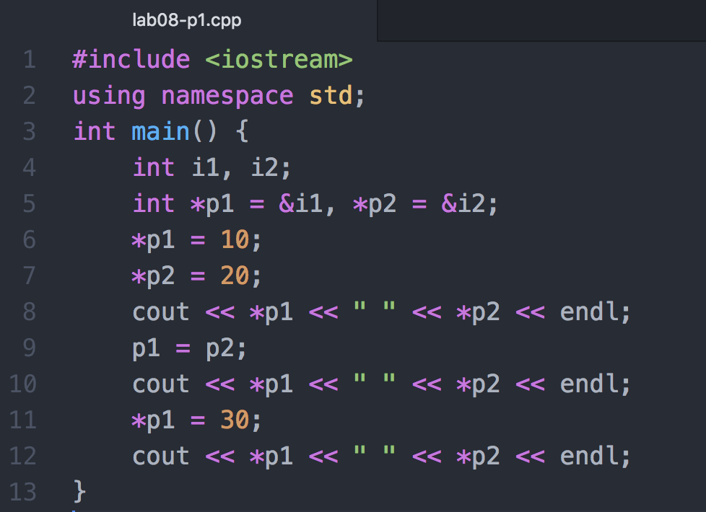
Problem 1
What is the output of the following program? Explain.
How would the output change if line 9 is replaced with *p1 = *p2? Explain.

Slide 27
Problem 2
What unfortunate misinterpretation can occur with the following declaration?
int* int_ptr1, int_ptr2;

